Slide 1
Thermal radiation
Basics
Thermal radiation of
Gases
Liquids, Solids
Previous papers
Species detection
Surface temperature measurements
IR cameras

Slide 2
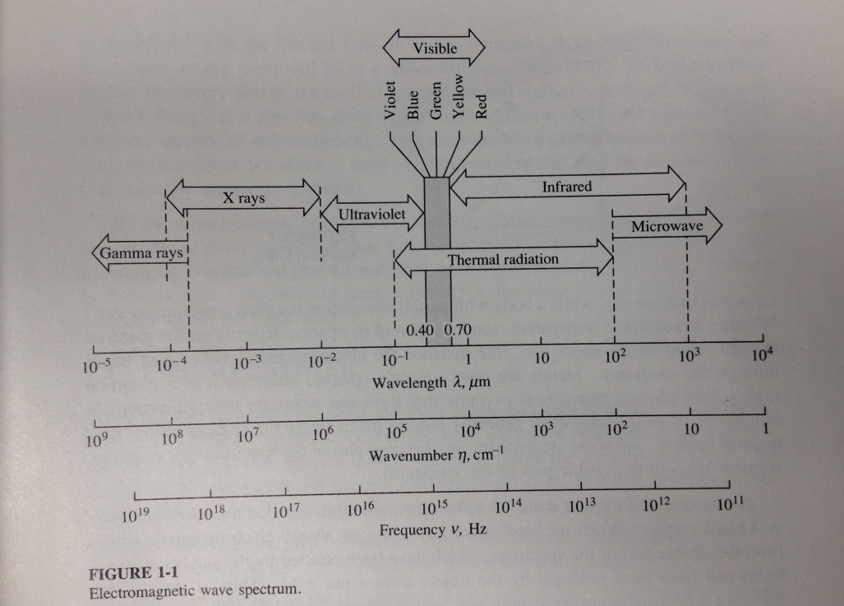
Thermal radiation
Wave / photons
Wave: liquids, solids, interfaces
Photon: gases
Energy, speed of light, frequency, wavelength:
c=c₀/n, c₀=2.998e8 m/s
c=λν
E=hν=hc/λ, h=6.626e-34 J.s: λ↗=>E↘

Slide 3
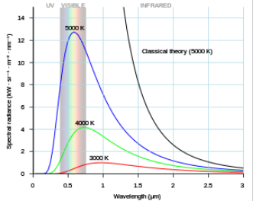
Thermal radiation
Blackbody emissive power:
E_{bb}(T,ν)=2πhν³n²/[c₀².(e^{hν/kT}-1)] W/(m².s)
E_{bb}(T,λ)=2πhc₀² /[n²λ⁵.(e^{hc/λkT}-1)] W/(m².μm)

Slide 4
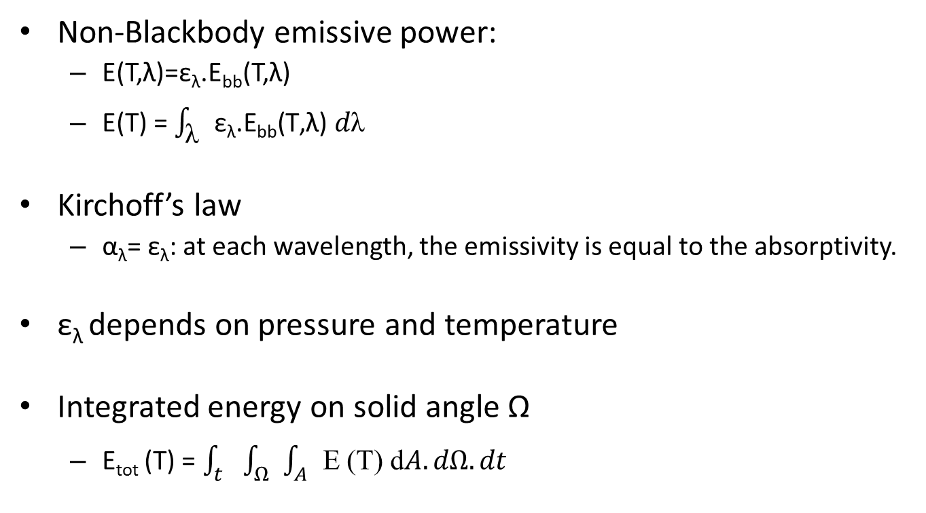
Thermal radiation
Non-Blackbody emissive power:
E(T,λ)=ε_{λ}.E_{bb}(T,λ)
E(T) = $\int_{\text{λ}}{\text{ε}\text{λ}\text{.}\text{Ebb}\text{(}\text{T}\text{,}\text{λ}\text{) }d\text{λ}}$
Kirchoff’s law
α_{λ}= ε_{λ}: at each wavelength, the emissivity is equal to the absorptivity.
ε_{λ} depends on pressure and temperature
Integrated energy on solid angle Ω
E_{tot} (T) = $\int_{t}{\int_{Ω}{\int_{A}{\text{E} \text{(}\text{T}\text{) }\text{d}A.dΩ.dt}}}$

Slide 5
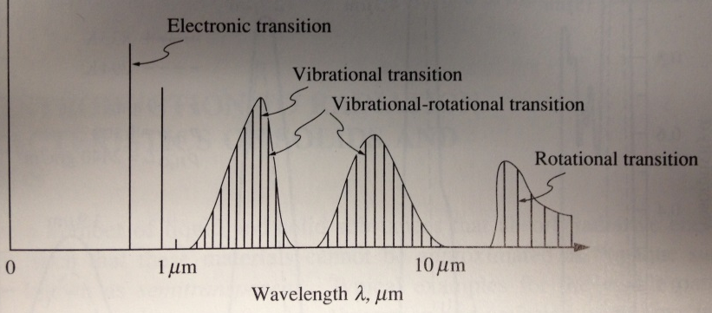
Thermal radiation
α+ρ+τ=1
Radiation of gases
Internal energy: electronic, vibrational, rotational
Quantification: only discrete values of photon energy hν can be absorbed/emitted
In case of thermal radiation, only vibrational and rotational levels are concerned.

Slide 6
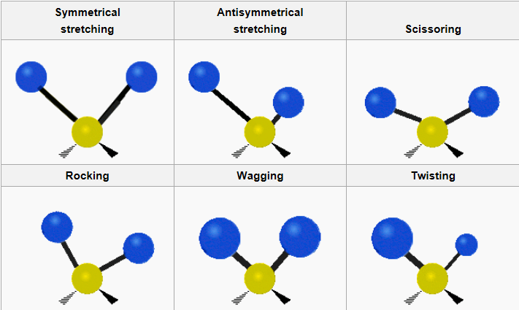
Thermal radiation
Radiation of gases
Stretching vs bending
N₂, O₂,…: no dipole moment, no radiation.

Slide 7
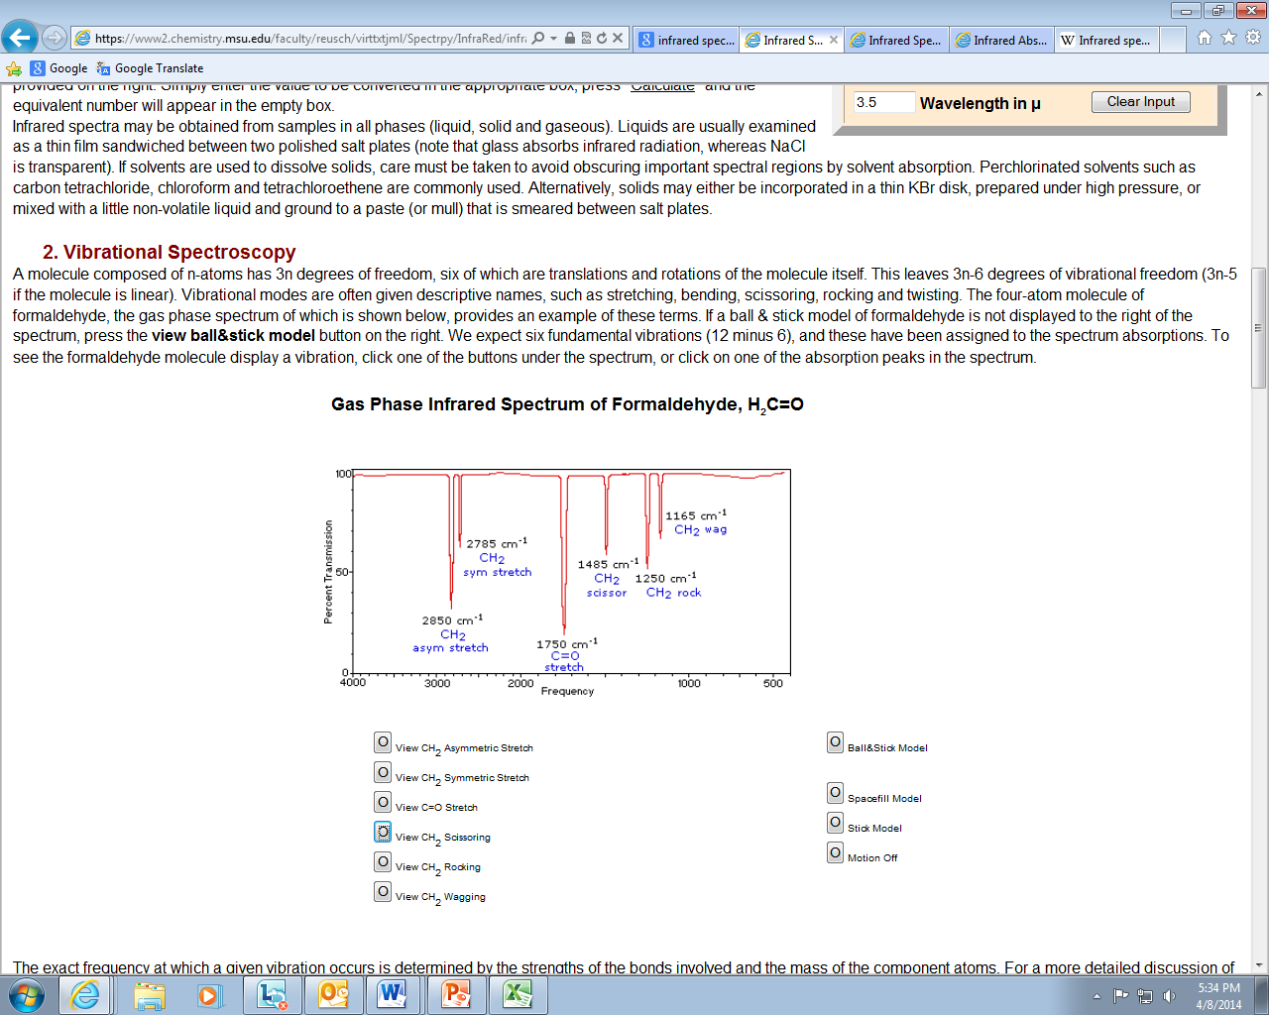
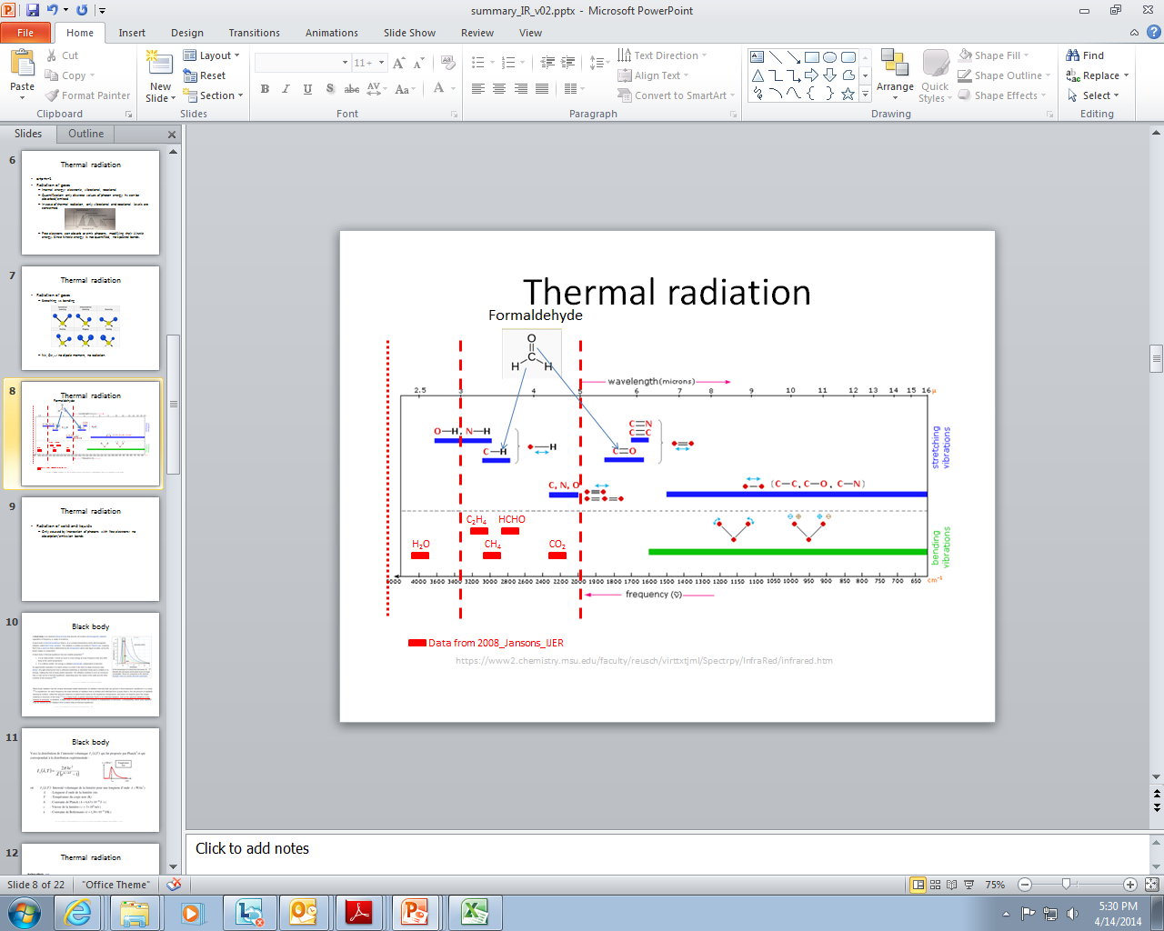
Thermal radiation
Radiation of gases
Group frequencies

Slide 8
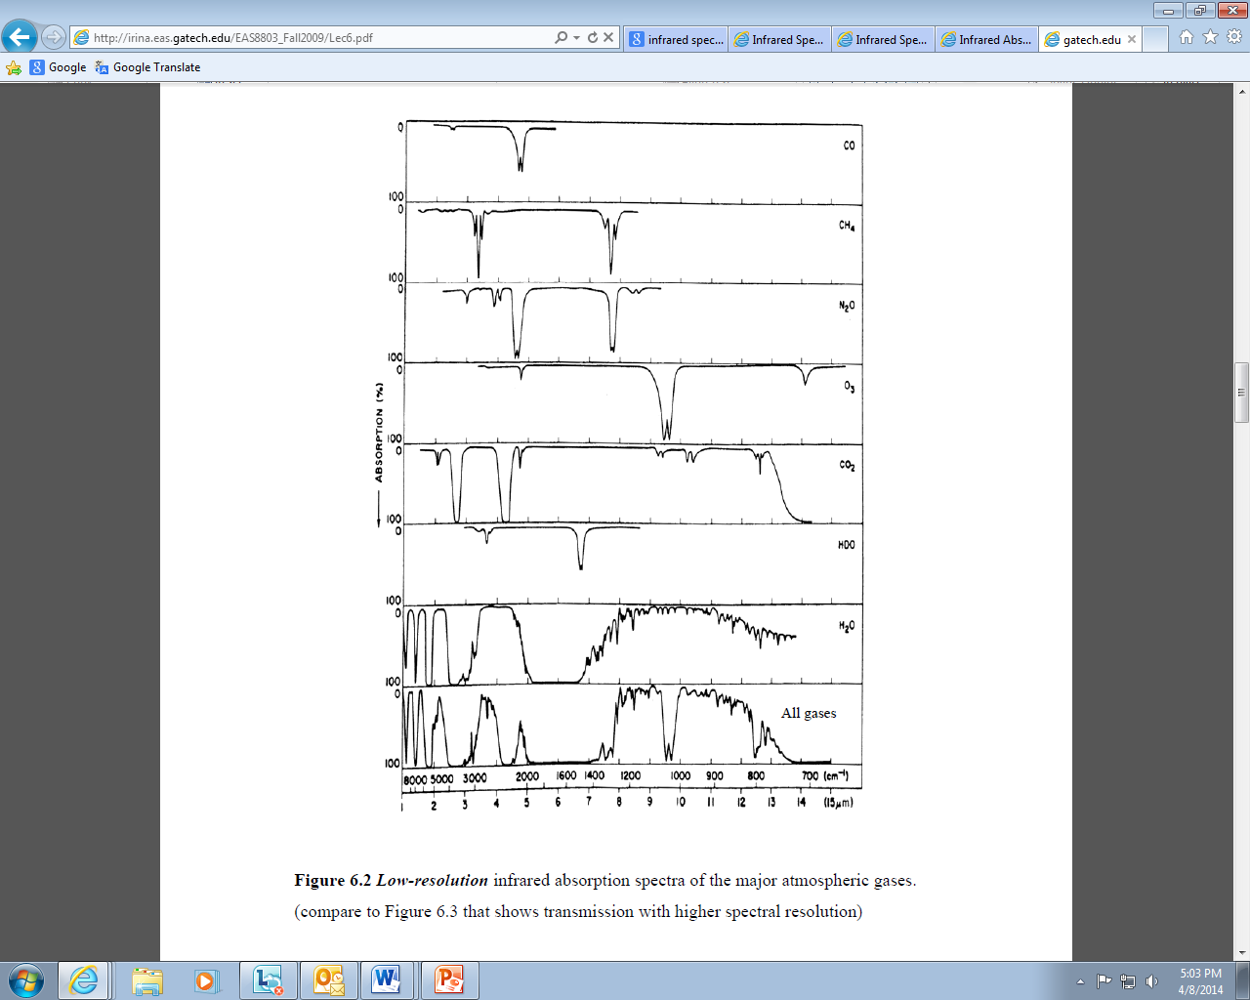
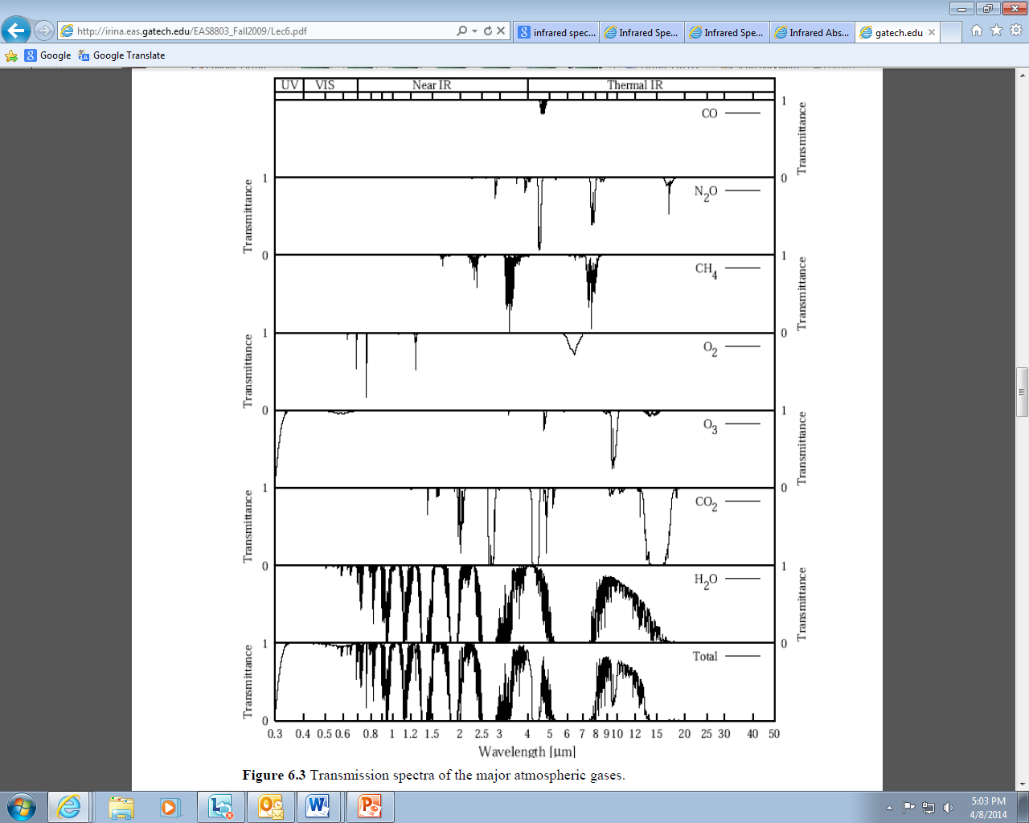
Thermal radiation
http://irina.eas.gatech.edu/EAS8803_Fall2009/Lec6.pdf

Slide 9
Thermal radiation
Radiation of solid and liquids
Only caused by interaction of photons with free electrons
Free electrons can absorb or emit photons, modifying their kinetic energy. Since kinetic energy is not quantified, no spectral bands.
In solids, also lattice vibration (phonon, crystal vibration)

Slide 10
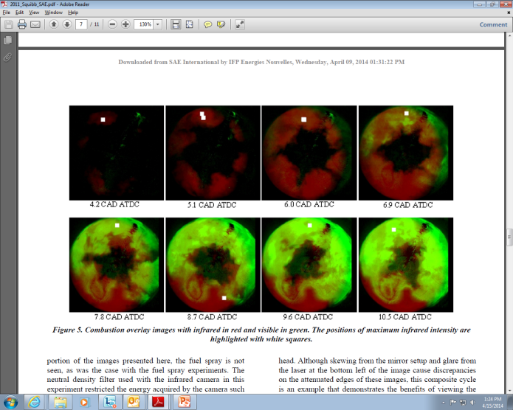
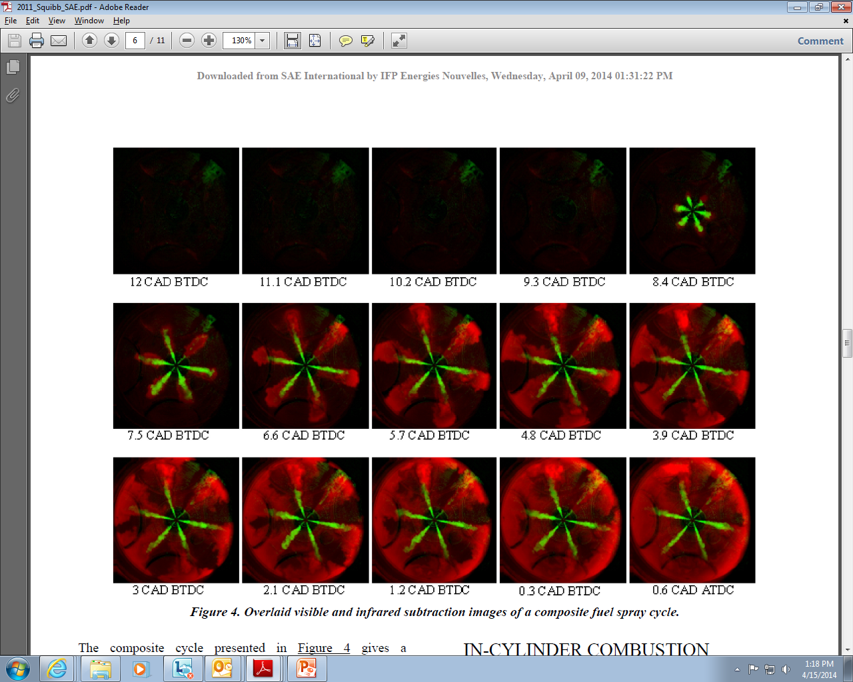
Previous work
Species detection – 1D measures
SAE 2007-01-0644: Grosch (Laser-Lab Gottingen). Fuel absorption @3.39μm (using a He-Ne laser) . SI engine. Fuel concentration near spark plug. Sapphire fiber, no absorption @ 3.39 μm.
SAE 2007-01-0639: Kakuho (Nissan), Hanson (Stanford). 2 colors Water absorption in near IR (around 1.4μm) + modulation. SI engine. Residual gas concentration and temperature near spark plug.
SAE 2007-01-1849: Kawahara (Obayama Univ.) CO2 absorption at 4.26μm . SI engine. Residual gas concentration.
SAE 2006-01-3337: De Francqueville (IFPEN). CO2 absorption at 4.26μm. SI engine. Residual gas concentration.
Species detection – 2D measures
SAE 1999-01-3494: Jansons (Rutgers). IR camera 2000Hz DI Diesel engine. Simultaneous IR emissions @ 2.2μm, 2.47μm (water), 3.42μm (preflame) and 3.8μm (soot). Qualitative images.
SAE 2000-01-1800: Jansons (Rutgers). IR camera 2000Hz SI and DI Diesel engines. Simultaneous IR emissions @ 2.2μm, 2.47μm (water), 3.42μm (preflame) and 3.8μm (soot). Qualitative images.
IJER 2008 9:215: Jansons (Wayne State), Lin & Rhee (Rutgers). IR camera 1880Hz SI and DI Diesel engines. Simultaneous IR emissions @ 2.1μm, 2.47μm (water), 3.43μm (preflame) and 3.8μm (soot). HITRANS modelling. HCHO signal week for SI engines.
SAE 2011-01-1395: Squibb (Michigan State). FLIR Phoenix MID, 60Hz. 3-5μm. 20μs integration time. Fuel sprays and combustion visualization. In-cylinder temperature.
Composite cycle
Composite cycle

Slide 11
Previous work
Surface temperature
App. Catal. A (2009) 365:301-308: Shakir (Waterloo Univ)
SAE 2010-01-1214: Epling (Waterloo Univ)
2D surface temperature of a catalyst. FLIR Merlin camera 1-5.4μm
SAE 2014-01-1446: Schulz (Magdeburg Univ.). 2D temperature measurements of a heated plate (80degC) impacted by gasoline sprays. 800Hz, 2 – 5.7μm.

Slide 12
IR cameras. FLIR vs TELOPS
Max frame rate
64x8
No square windowing for FLIR
64x64
128x128
1degV @ 1250rpm
640x32
320x256
640x512
640x128

Slide 13
IR cameras. FLIR vs TELOPS
Integration time
Max Photons = Max Energy = Φ_{3-5μm}(T).τ
Data FLIR: F/2.5
Temp range (degC) | Pbb: Corresponding BB emissive power (Planck's law) integrated between 3mu et 5mu | Tint: Recommended integration time | Ebb=Pbb*Tint: Energy emitted by the BB during the integration time | Maximum frame rate based on integration time
degC | W/m2/mu | ms | J/m2/mu | Hz
-20 to 50 | 0.78 to 15 | 1.1424 | 0.89 to 17.14 | 875
10 to 90 | 3 to 39 | 0.472 | 1.42 to 18.41 | 2119
35 to 150 | 7.7 to 148 | 0.1321 | 1.02 to 19.55 | 7570
80 to 200 | 30.3 to 350 | 0.0568 | 1.72 to 19.88 | 17606
150 to 350 | 148 to 2130 | 0.0094 | 1.39 to 20.02 | 106383
Data Telops: F/2.3 + fill factor 80pc
Integration time for Telops FAST IR 1500
Temp range (degC) | Pbb: Corresponding BB emissive power (Planck's law) integrated between 3mu et 5mu | Tint: Recommended integration time | Ebb=Pbb*Tint: Energy emitted by the BB during the integration time | Maximum frame rate based on integration time
degC | W/m2/mu | ms | J/m2/mu | Hz
0 | 1.988 | 0.48 | 0.95424 | 2083
50 | 12.6 | 0.19 | 2.394 | 5263
100 | 50 | 0.06 | 3 | 16667
150 | 148 | 0.022 | 3.256 | 45455
200 | 350 | 0.01 | 3.5 | 100000

Slide 14
IR cameras. FLIR vs TELOPS
Integration time
Max Photons = Max Energy = Φ_{3-5μm}(T).τ
Data FLIR: F/2.5
Temp range (degC) | Pbb: Corresponding BB emissive power (Planck's law) integrated between 3mu et 5mu | Tint: Recommended integration time | Ebb=Pbb*Tint: Energy emitted by the BB during the integration time | Maximum frame rate based on integration time
degC | W/m2/mu | ms | J/m2/mu | Hz
-20 to 50 | 0.78 to 15 | 1.1424 | 0.89 to 17.14 | 875
10 to 90 | 3 to 39 | 0.472 | 1.42 to 18.41 | 2119
35 to 150 | 7.7 to 148 | 0.1321 | 1.02 to 19.55 | 7570
80 to 200 | 30.3 to 350 | 0.0568 | 1.72 to 19.88 | 17606
150 to 350 | 148 to 2130 | 0.0094 | 1.39 to 20.02 | 106383
Data Telops: F/2.5 + fill factor 100pc
Temp range (degC) | Pbb: Corresponding BB emissive power (Planck's law) integrated between 3mu et 5mu | Tint: Recommended integration time | Ebb=Pbb*Tint: Energy emitted by the BB during the integration time | Maximum frame rate based on integration time
degC | W/m2/mu | ms | J/m2/mu | Hz
0 | 1.988 | 0.7089 | 1.4093 | 1411
50 | 12.6 | 0.2806 | 3.5356 | 3564
100 | 50 | 0.0886 | 4.4305 | 11285
150 | 148 | 0.0325 | 4.8086 | 30778
200 | 350 | 0.0148 | 5.1690 | 67712

Slide 15
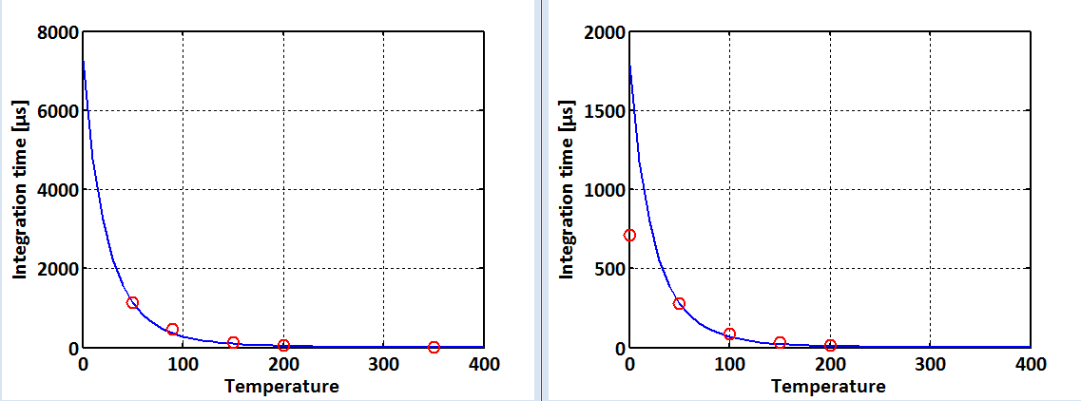
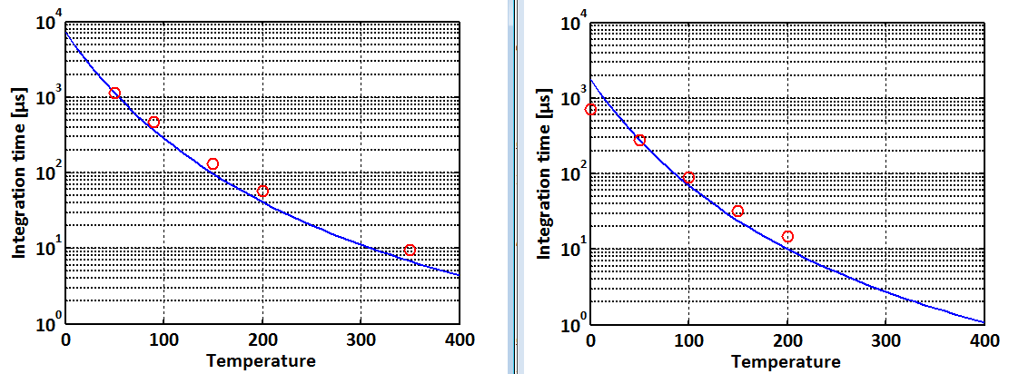
IR cameras. FLIR vs TELOPS
Integration time
Max Photons = Max Energy = Φ_{3-5μm}(T).τ
FLIR
Telops

Slide 16
IR cameras. FLIR vs TELOPS
Noise: NEdT
NEdT = StdDev(I)*ΔT/ ΔI
FLIR: 18mK
Telops: 18mK

Slide 17
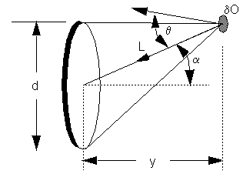
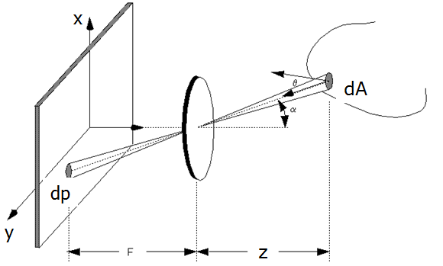
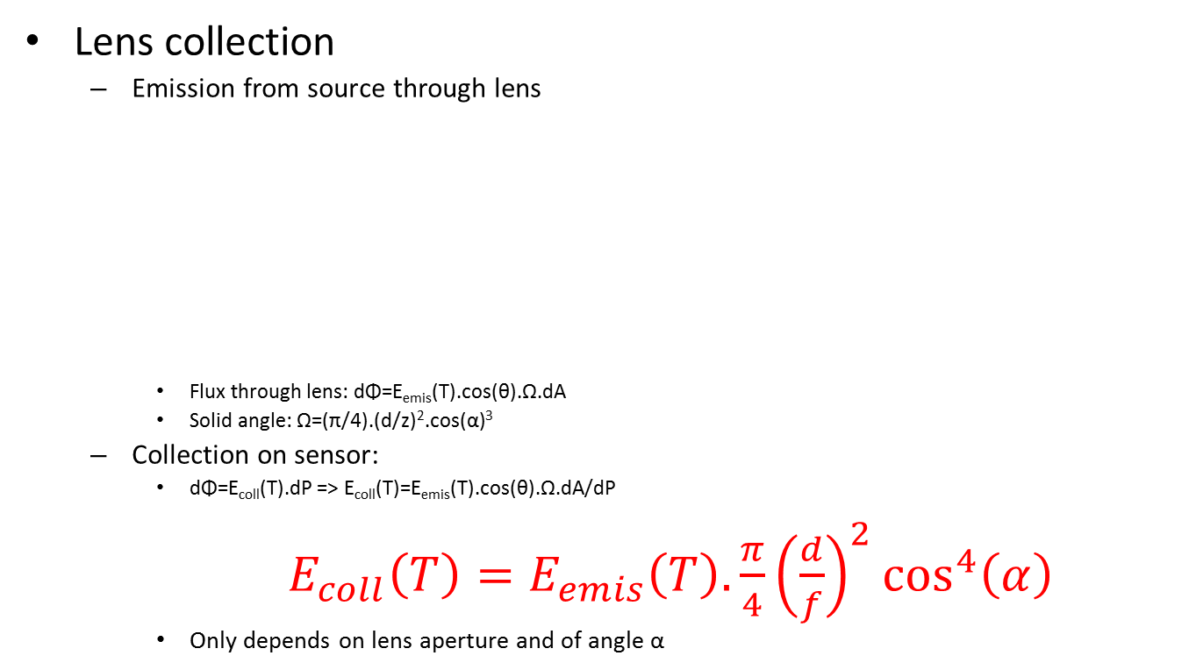
IR cameras
Lens collection
Emission from source through lens
Flux through lens: dΦ=E_{emis}(T).cos(θ).Ω.dA
Solid angle: Ω=(π/4).(d/z)².cos(α)³
Collection on sensor:
dΦ=E_{coll}(T).dP => E_{coll}(T)=E_{emis}(T).cos(θ).Ω.dA/dP
$E_{coll}\left(T\right)=E_{emis}\left(T\right).\frac{π}{4}{\left(\frac{d}{f}\right)}^{2}\cos^{4}\left(α\right)$
Only depends on lens aperture and of angle α

Slide 18
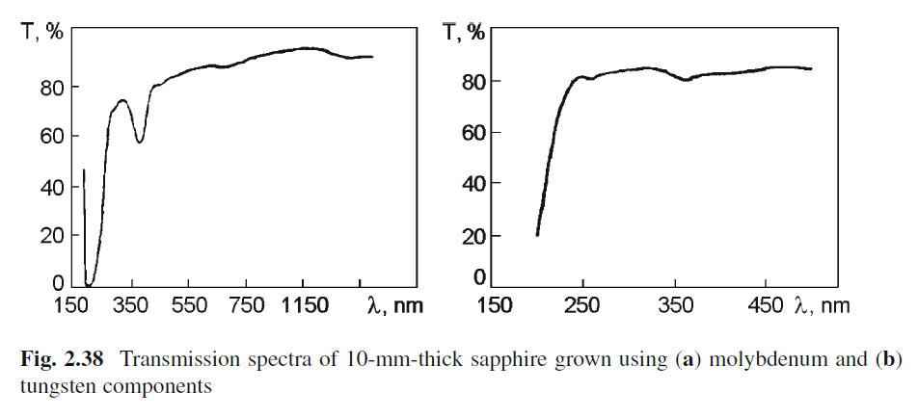
Transmission sapphire
http://www.google.com/url?sa=t&rct=j&q=&esrc=s&frm=1&source=web&cd=8&cad=rja&uact=8&ved=0CFYQFjAH&url=http%3A%2F%2Fwww.springer.com%2Fcda%2Fcontent%2Fdocument%2Fcda_downloaddocument%2F9780387856940-c1.pdf%3FSGWID%3D0-0-45-719708-p173851708&ei=wWZFU8uAOrTUsAT404DABA&usg=AFQjCNGmYizK7Mr9JX6iAJXR5zeYsQ3ogQ&bvm=bv.64507335,d.dmQ

Slide 19
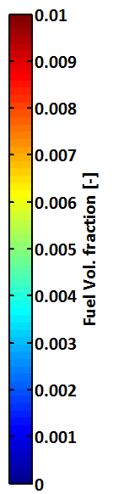
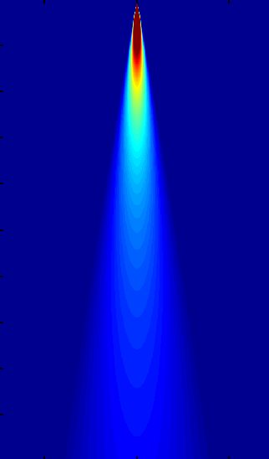
Detection of vaporized fuel
Case of study: IR camera looking at the spray from the side
Along the gray arrow, the intensity I evolves as:
dI_{λ}/dr = κ_{λ}I_{bλ}- κ_{λ}I _{λ}(r)
Where κ_{λ} = α_{λ}.c(r),
α_{λ} being the absorption coefficient and c the concentration of the fuel
Collected IR
y
r
z

Slide 20
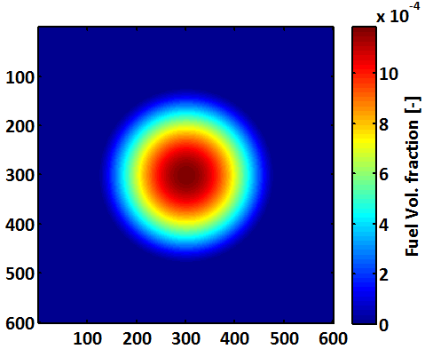
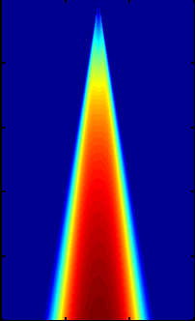
Detection of vaporized fuel
Look a cross-section of the spray at distance z
For n-heptane, at 3.4µm, we have abosrbance:
A=log(I/I₀) ≈ 1.9, for 30mmHg n-Heptane and a path length of 0.05m, at 20°C.
This gives α_{λ}=-ln(10^{αλ})/(L.c)≈70 (mol.m⁻³)⁻¹.m⁻¹
I_{λ}(r+dr) = I_{λ} (r)+ α_{λ}.c(r).[I_{bλ}- I _{λ}(r)]
Emission collected by the camera
Collected IR
y
=> Apparently, no decrease of the signal in the spray tip region (higher temperature), which should make the detection of the borders of the spray quite easy.
z
r

Slide 21
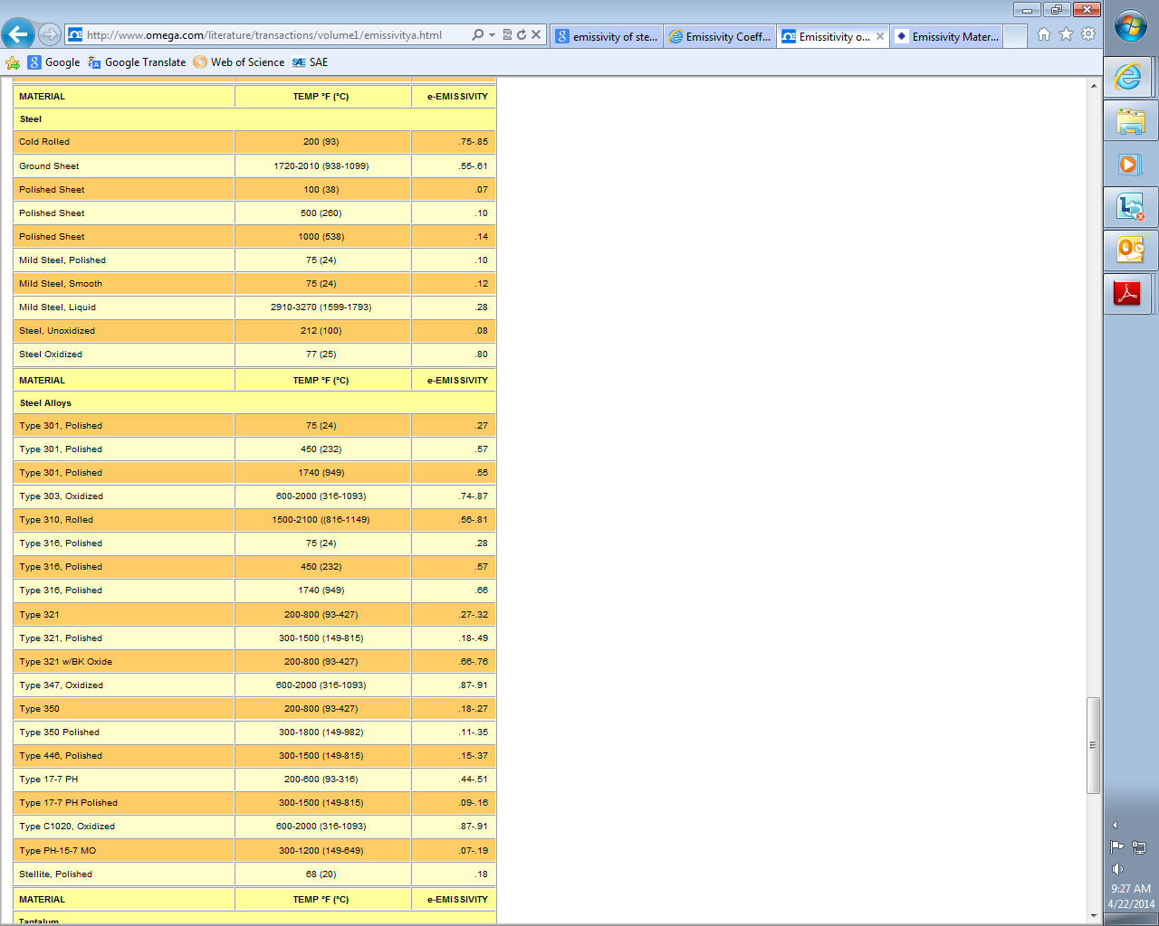
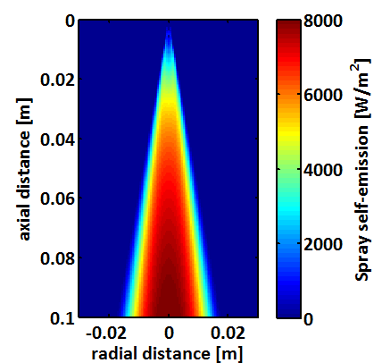
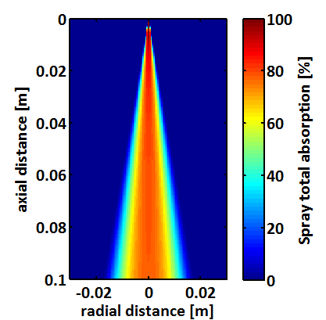
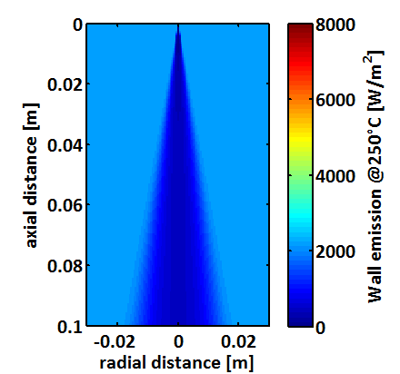
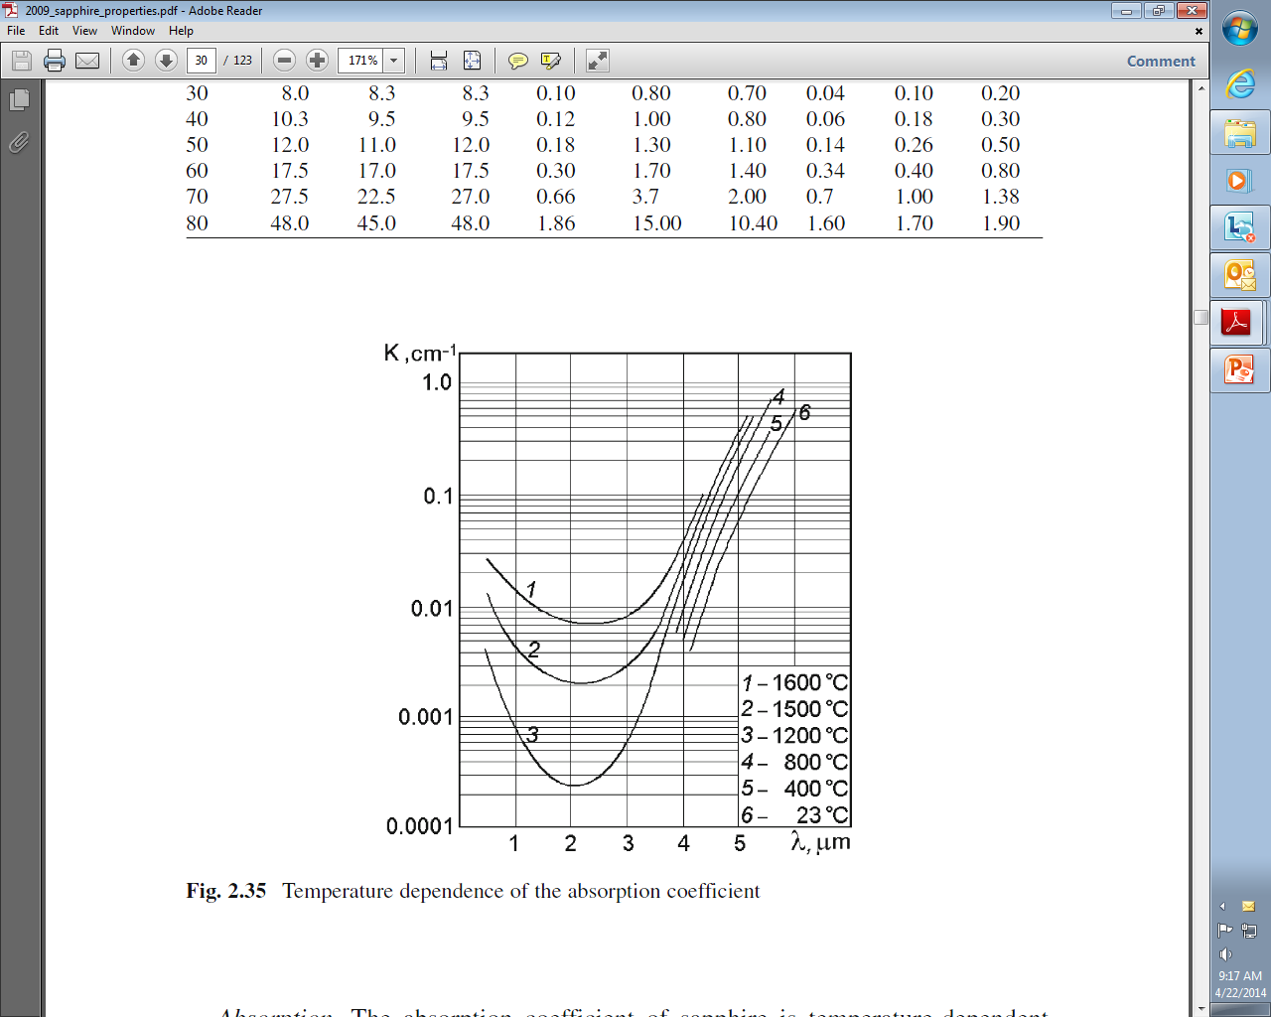
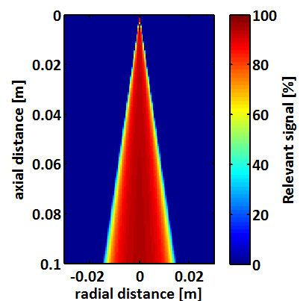
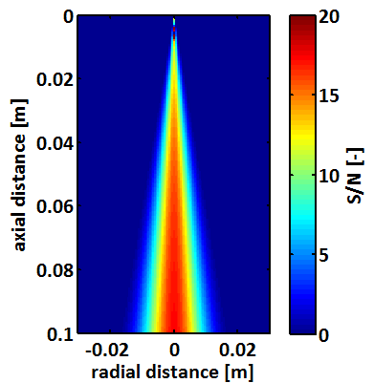
Detection of vaporized fuel
Self-emission from the spray
Total absorption of the spray
BG noise from wall
Abs. Coef.: 0.01cm⁻¹ @3.4µm
Thickness: 2cm
Self-emission: 42W/m²
Transmission: 98%
Relevant signal
S/N
Wall
Sapphire window

Slide 22
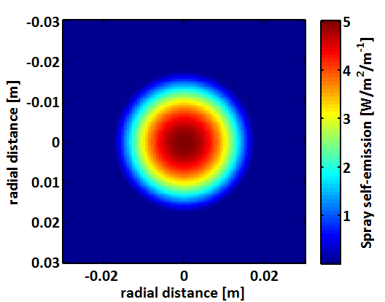
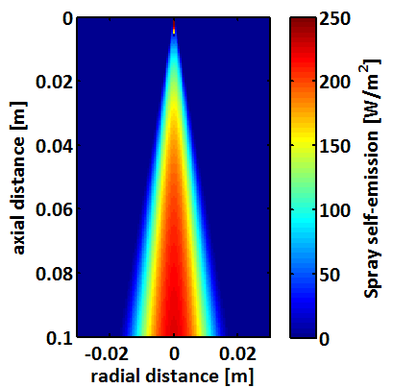
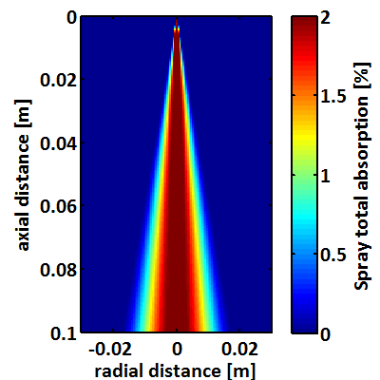
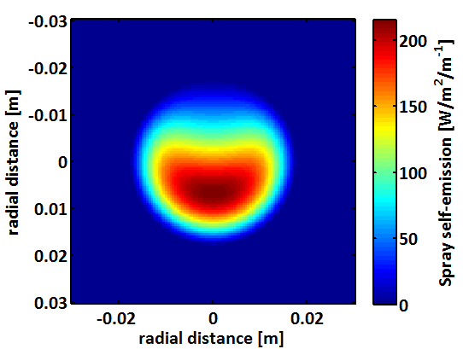
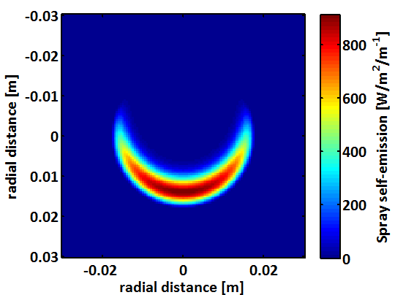
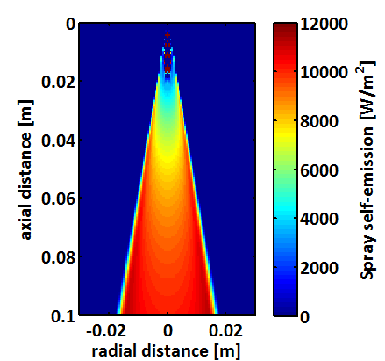
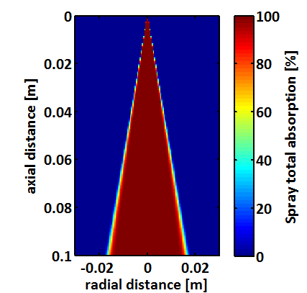
Detection of vaporized fuel
Effect of absorption coefficient α
Cross-section emission of the spray
Self-emission of the spray
Total absorption of the spray
α =1 (mol.m⁻³)⁻¹.m⁻¹
α =70 (mol.m⁻³)⁻¹.m⁻¹
α =1000 (mol.m⁻³)⁻¹.m⁻¹

Slide 23
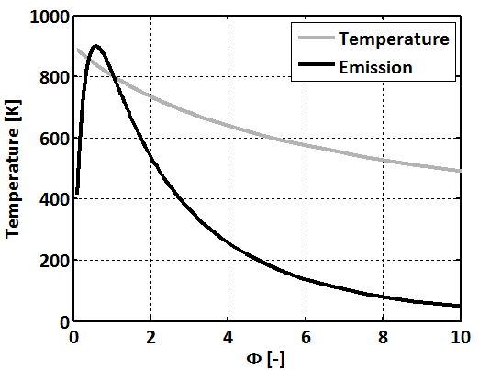
Emission from a sample of fuel
Fuel at cst Φ
T: adiabtic mixing
P=60b
Normalized emission (a.u.)
L=20mm

Slide 24
Precision of the measurements
NETD:
Camera looks at a scene at constant temperature.
P_{i}(t): value of pixel #i at instant t
μ_{i}: temporal average of P_{i}(t)
σ_{i}: standard deviation of P_{i}(t)
NETD=average value of σ_{i} for all the pixels of the chip, converted into temperature (NETD=NETD_{counts}*ΔT/Δcounts).
For Telops FAST-IR 1500, NETD ≈23mK, and σ_{NEDT} ≈5-6mK.
For FLIR SC6800, NETD<20mK.
σ_{NEDT}
σ_{i}
NEDT

Slide 25
Precision of the measurements
Accuracy:
Camera looks at a scene at constant temperature T₀.
P_{i}(t): value of pixel #i at instant t
μ_{i}: temporal average of P_{i}(t)
For different sensors, T₀ – μ_{i} follows a gaussian function. Its standard deviation is the accuracy.
For Telops FAST-IR 1500, accuracy is +/-1ºC.
For FLIR SC6800, accuracy is +/-2ºC.
Accuracy
μ_{i}
T₀

Slide 26
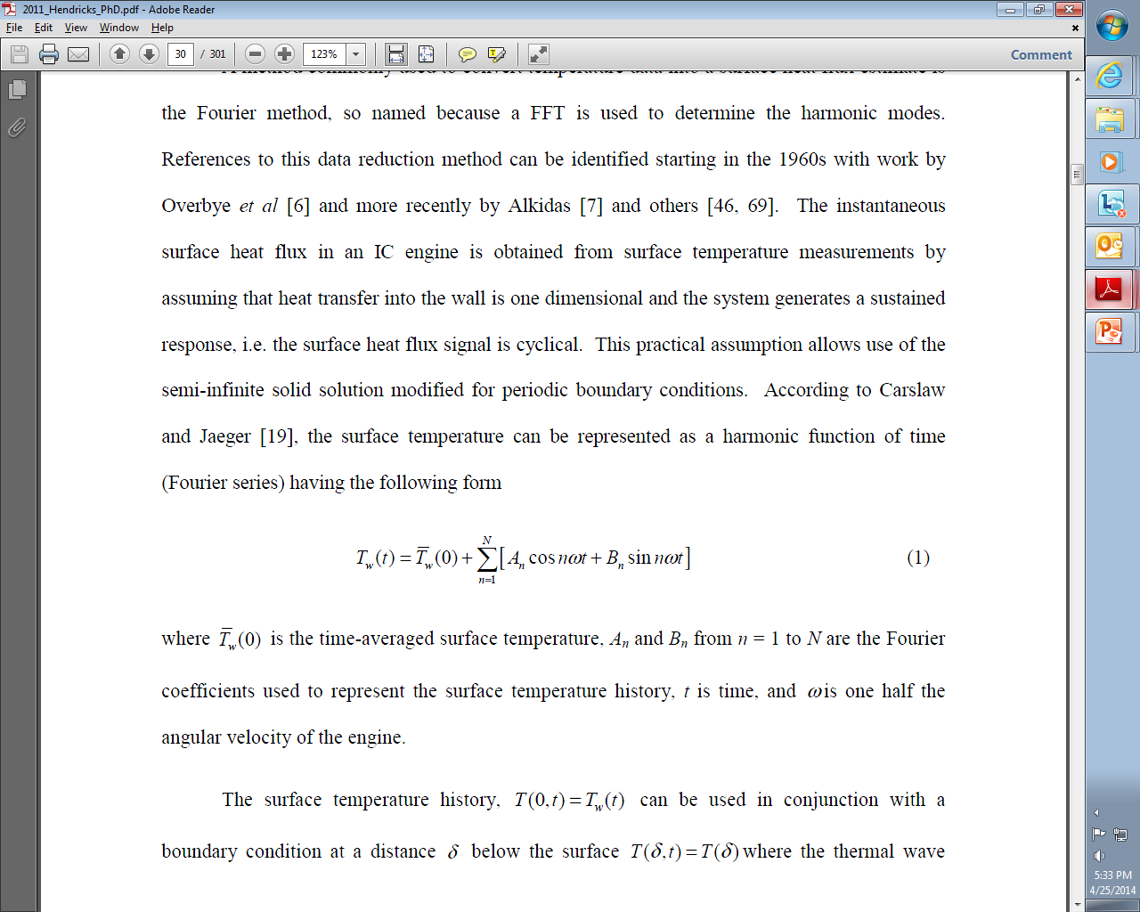
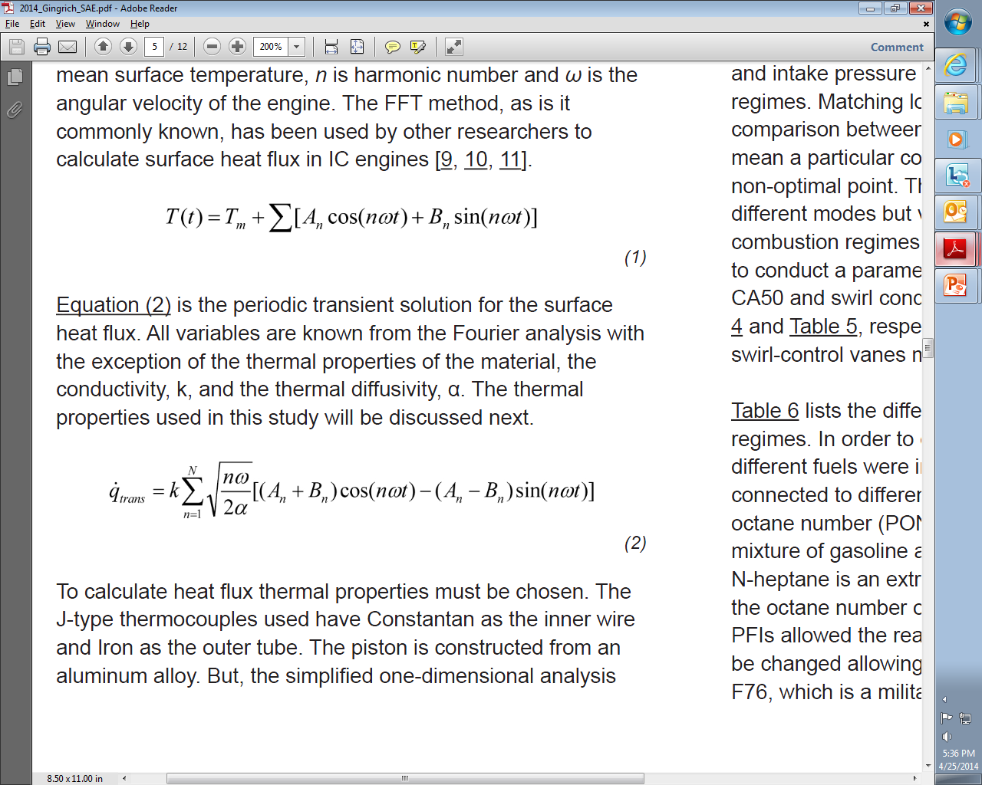
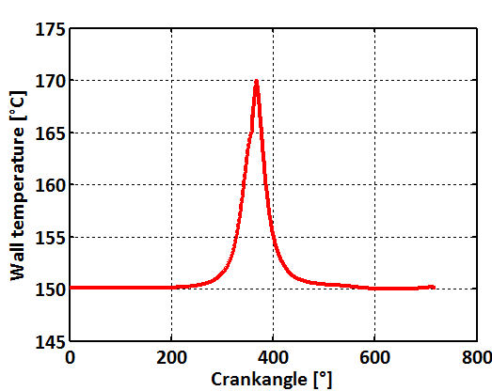
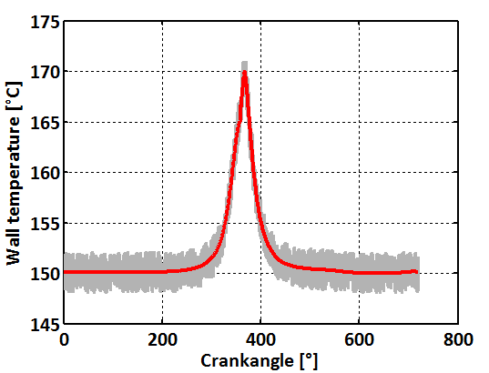
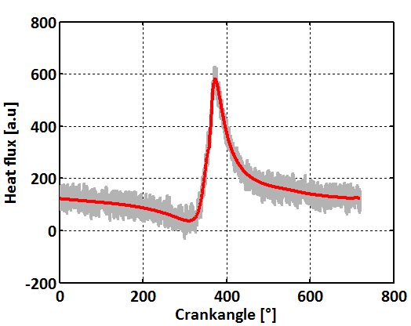
Impact of measurement errors on heat flux results
Surface temperature T can be decomposed in Fourier series:
Then, the transient part of the heat flux is given by:
T_{w}(t)
T_{w}(t)+noise
q

